Slide 1

2GA3 Tutorial #4
DATE: October 8th, 2021
TA: Jatin Chowdhary

Slide 2
Anonymous Feedback
Spend ~4 Mins
  Feedback on course/tutorial/content/etc.
100% Anonymous
  I’m leaving the room
  If you’re paranoid about anonymity, write with your other hand
    Then no one will be able to recognize your answers
Be Honest
  “The whole truth and nothing but the truth“
    My cholesterol is high enough

Slide 3
Minor Stuff
Expect Typos
  Keyboard is breaking down
    Keys are hard to press
  The S & T keys
Low Energy?
  Let me know!
Reading Week
  Don’t waste your time
    Study for the midterm
      It’s gonna be long and hard

Slide 4
Major Stuff
Note Taking?
  No need
    Everything is, or will be posted
  Just participate
    Because r _ _ _ _ _ _ _ _ _ _ _ is the language of the b _ _ _ _
    Participation = R _ _ _ _ _ _ _ _ _ _ _
  When you go home, then take notes
    You’ll be surprised at your retention rate

Slide 5
Review (1)
Question: What are registers?
Options:
  A) Measure of how fast a processor performs operations
  B) Where CPUs temporarily store and process information
  C) The bridge between the CPU and RAM
  D) Used to store money at the store
  E) Secondary storage in a computer

Slide 6
Review (2)
Question: Which of the following are part of the main memory hierarchy?
Options:
  A) Registers
  B) Cache
  C) RAM
  D) All of the above
  E) None of the above

Slide 7
Review (3)
Question: Main memory is…
Options:
  A) Fast and non-volatile
  B) Slow and non-volatile
  C) Fast and volatile
  D) Slow and volatile
  E) None of the above

Slide 8
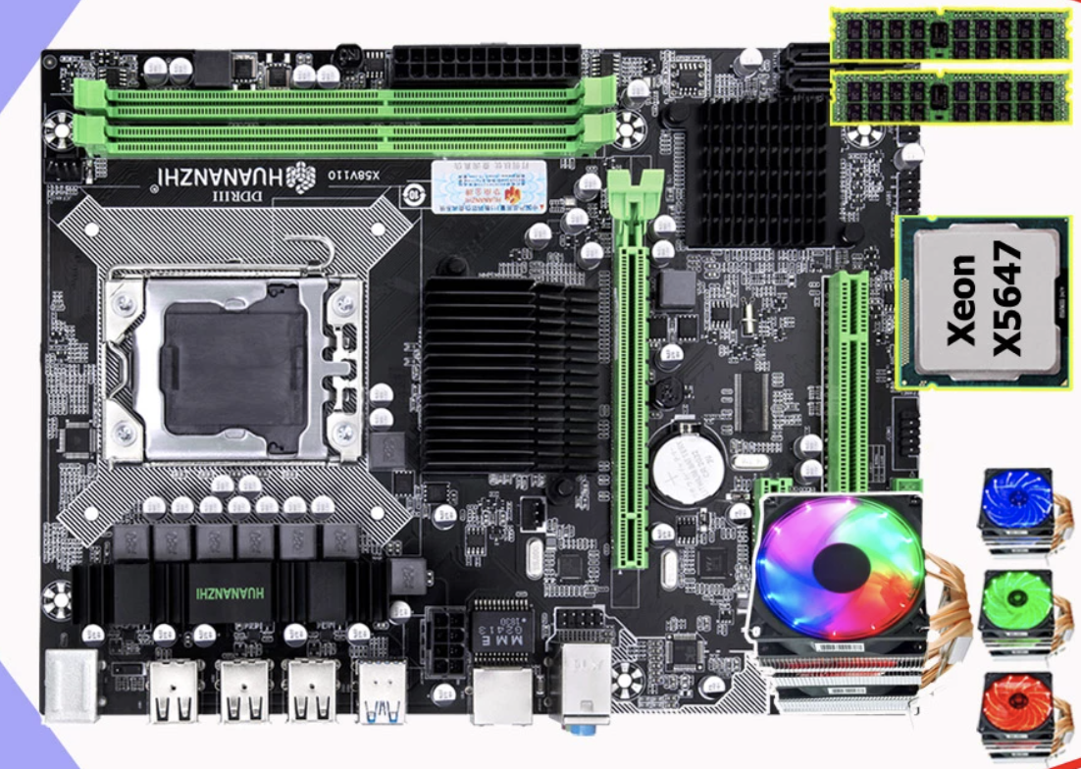
CPU & Memory
MEMORY
CPU

Slide 9
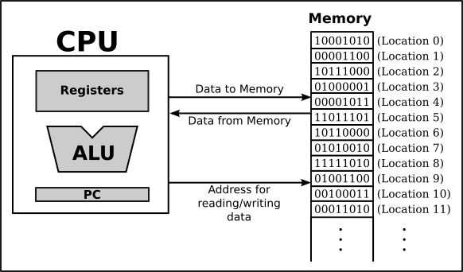
Abstract View

Slide 10
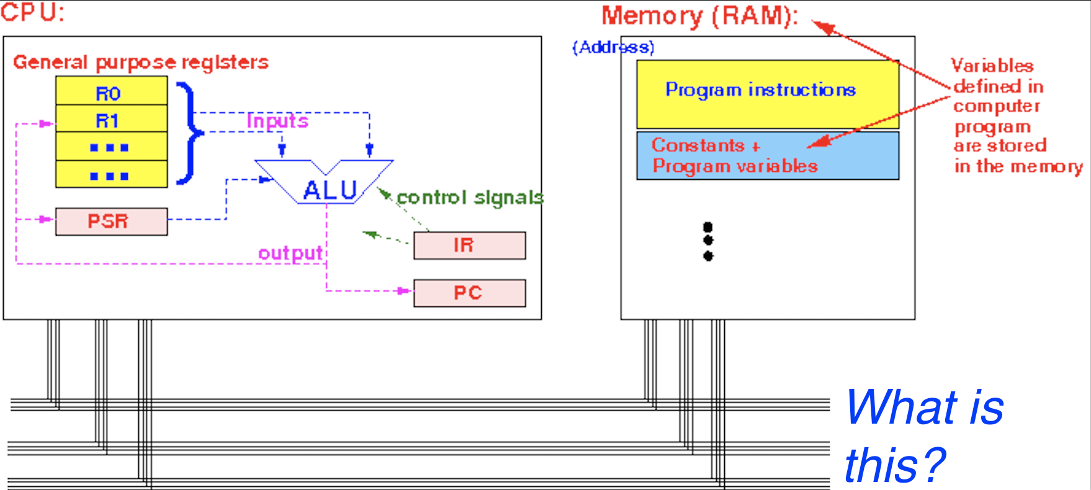
More Abstraction
Everything in memory is either a 0 or a _
Information is sent over the _ _ _
R _ _ _ _ _ _ _ _ are found in the CPU
ALU stands for…?
RAM stands for…?
PC stands for…?

Slide 11
Review (4)
Question: Which of the following base-number systems are invalid?
Options:
  A) Base-4
  B) Base-12
  C) Base-20
  D) Base-60
  E) All of the above
  F) None of the above

Slide 12
Review (5)
Question: Can we use base-3 or base-4 number systems instead of base-2, in a computer? In other words, instead of a high/low voltage, there’ll be 3, 4, etc. voltage(s)
Options:
  A) Yes
  B) No
  C) Maybe
  D) I don’t know
  E) Can you repeat the question?
Next slide…

Slide 13
Base ‘X’
Question: Can we use base-3 or base-4 number systems instead of base-2, in a computer?
  Answer: Yes we can.
    But we don’t, because:
      Harder to implement
      More complexity
      Boolean logic was established before computers
      Noise
        Need a clear distinction between 0 (false) and 1 (true)

Slide 14
Why Bother With Hex?
Question: What is the point of hexadecimal?
  Asked by Emily
Answer: It’s a better way to represent binary-coded values
  Each hexadecimal ‘‘character’’ represents 4 bits
    Bit = Binary Digit
  Reading hex numbers is easier than reading binary numbers
  Used by computer scientists, chip designers, hackers, etc.
    Hackers use disassemblers to study how a program works, find vulnerabilities, and recreate the original code (as much as they can)
      i.e. IDA (on next slide)

Slide 15
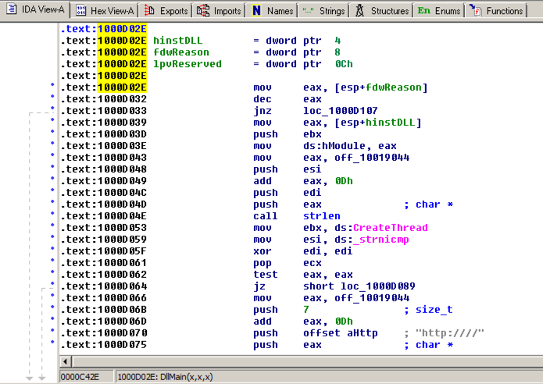
IDA (Pro)

Slide 16
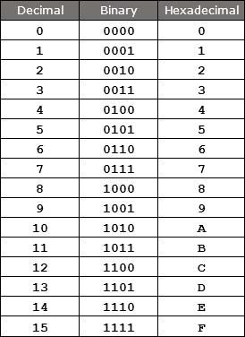
More Hexadecimal
4 bits (binary digits) can be represented by a single hexadecimal ‘‘character’’
  Much easier to read 0x000A, than it is to read 0b0000000000001010
    Imagine how long a 32-bit or 64-bit number would be. Using hex makes sense
Question: Which of the following is a hexadecimal number?
Options:
  0x10101
  0b00AB
  (00FF)10
  ‘‘ABC’’
  (54321)6

Slide 17
Review (6)
Question: What is the difference between add and addi?
Options:
  A) There is no difference; it’s the same thing
  B) add is for large numbers; addi is for small numbers
  C) add is for 32-bit; addi is for 64-bit
  D) add adds the values in 2 registers; addi adds a constant value to a register
  E) None of the above

Slide 18
Which Add?
Question: Which instruction syntax corresponds to add & addi?
  rd, rs1, rs2 is the syntax for XXX
  rd, rs1, imm is the syntax for XXX
Note: XXX is the instruction

Slide 19
Registers Abbreviated
rs = Register Source
rd = Register Destination
imm = Immediate
  Also known as c _ _ _ _ _ _ _
  Example?

Slide 20
RISC-V Registers
Question: Can the instruction list/set be used to determine which register is which?
  Asked by Liam
Answer: Nope, you should use the GreenCard, to determine which register is which. Then, use the InstructionList to convert RISC-V assembly to machine code
  Demo

Slide 21
Base Address
Question: something something… Base address… something something?
  Asked by Liam
Answer: Think about it like this
  <name> takes my lunch money, and the only thing I know is that <name> lives at Cowboy Court, 5th house down, from where the Court starts
    Where does <name> live?
      Next slide

Slide 22
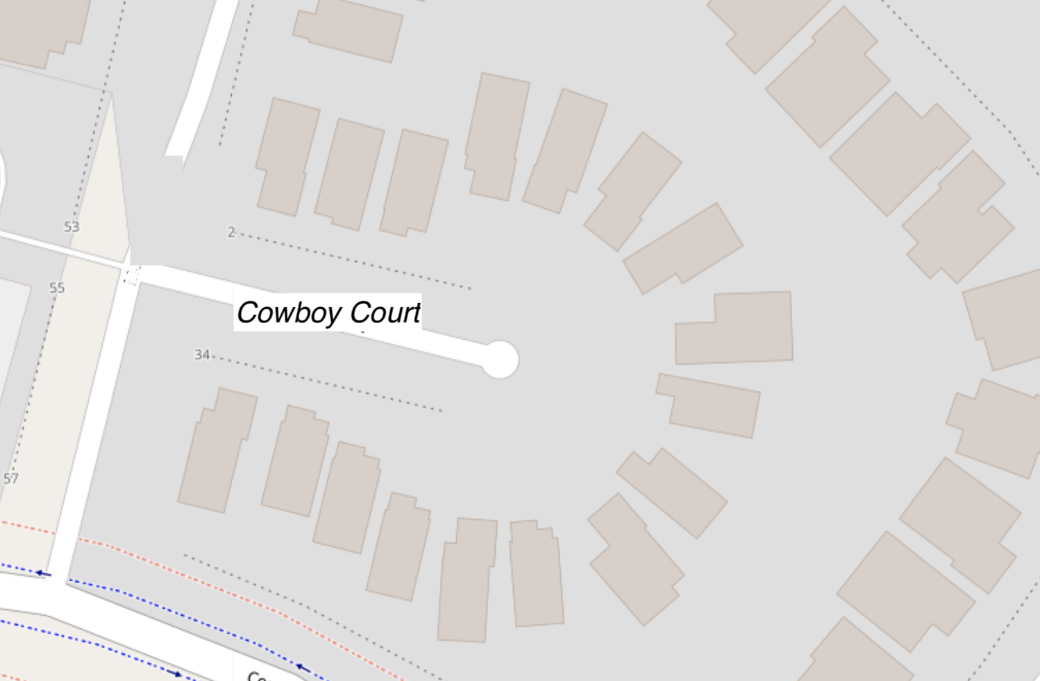
Cowboy Court

Slide 23
Cowboy Court (Labelled)

Slide 24
Abstraction → Application
How does it work in practice?
  i.e. int.arrays.c
    i.e. diagram.int.array.txt
  i.e. double.arrays.c
    i.e. diagram.double.array.txt

Slide 25
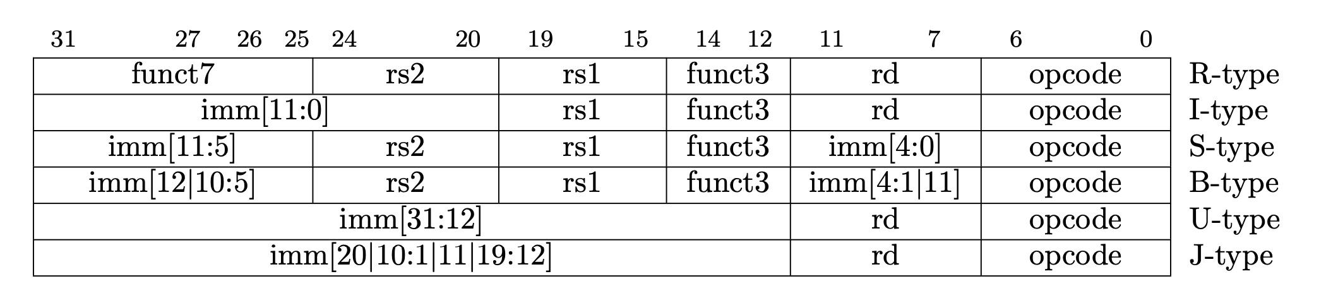
Immediate(s)
Question: Why is immediate split up?
  Can’t remember who asked this
Answer: To keep the format/structure of the instruction the same
  Makes decoding easier
    Consistency is good
  Size and place/location should be consistent

Slide 26
Instruction Type
Question: What type of instruction is sw?
  What does sw stand for?
    Is sw used for 32-bit or 64-bit architecture?
Options:
  A) R-type
  B) I-type
  C) B-type
  D) U-type
  E) S-type
  F) J-type

Slide 27
Question #1 (2.27)
Translate the following RISC-V assembly code into C. Assume that the variable i is stored in register x6, result is stored in x5, and x10 holds the base address of an array called MemArray.
  Assembly code on next slide

Slide 28
Question #1 (2.27)
.data
MemArray:
    .word 0
    .word 1
    …
    .word 2
    .word 99
.text
      addi x6, x0, 0
      addi x5, x0, 0
      addi x29, x0, 100
  LOOP:
      lw x7 0(x10)
      add x5, x5, x7
      addi x10, x10, 4
      addi x6, x6, 1
      blt x6, x29, LOOP
Recall that:
  x6 = i
  x5 = result
  X10 = Base address of MemArray

Slide 29
Answer #1 (2.27)
Solution #1:
  int i;
  int result = 0;
  for (i = 0; i < 100; i++) {
  result += *MemArray;
  MemArray++;
  }
  return result;
Solution #2:
  int i;
  int result = 0;
  for (i = 0; i < 100; i++) {
  result += MemArray[i];
  }
  return result;

Slide 30
Clarifications #1 (2.27)
Question: Can a while loop be used instead of a for loop?
  Answer: Yes! Semantically speaking, there is little difference between a for loop and a while loop.
    Programmers prefer for loops because they are quicker to write, BUT not quicker to execute on the CPU
Question: Why are there 2 solutions?
  Answer: Because C code to assembly isn’t a 1:1 mapping. When you compile C code, the output depends on what you’ve written AND the what the compiler does (i.e. The compiler may make optimizations)

Slide 31
Question #2 (2.31)
Translate function f into RISC-V assembly language. Assume the function declaration for g is int g(int a, int b).
The code for function f is as follows:
  int f (int a, int b, int c, int d) {
    return g(g(a,b), c+d);
  }
Note: For a question like this, you will have to specify registers yourself. (i.e. I will assume that variable ‘‘abc’’ is stored in register ‘‘yyz’’.
  Thus, you will need to reference the RISC-V Calling Convention

Slide 32
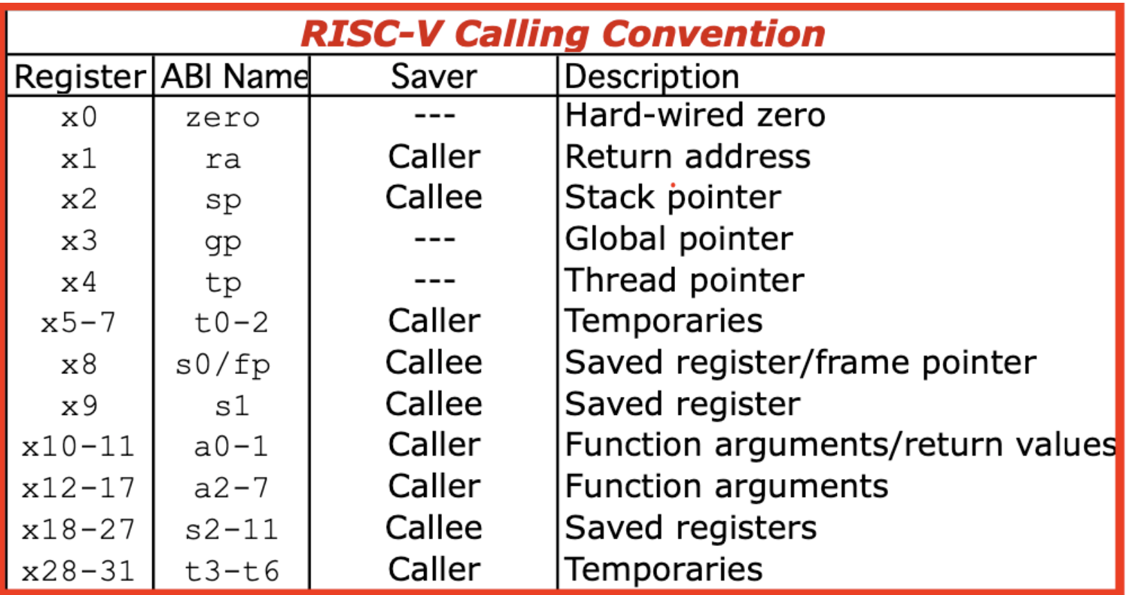
Calling Convention

Slide 33
Answer #2 (2.31)
f:
  addi x2, x2, -8 // Allocate stack space for 2 words
  sw x1, 0(x2) // Save return address
  add x5, x12, x13 // x5 = c + d
  sw x5, 4(x2) // Save x5, which is c + d, on the stack
  jal x1, g // Call x10 = g(a,b)
  lw x11, 4(x2) // Reload x11 = c + d, from the stack
  jal x1, g // Call x10 = g(g(a,b), (c + d))
  lw x1, 0(x2) // Restore return address
  addi x2, x2, 8 // Restore stack pointer
  jalr x0, 0(x1) // Return to caller, f

Slide 34
Question #3 (2.37)
Question: Write the RISC-V assembly code to implement the following C code as an atomic “set max” operation using the lr.d and sc.d instructions. Here, the argument shvar contains the address of a shared variable which should be replaced by y if y is greater than the value it points to. Assume x10 is address of integer pointed by shvar and value of y is in x11.
Code:
  Next slide

Slide 35
Question #3 (2.37)
Code:
  void setmax(int* shvar, int y) {
  // Begin critical section
  if (y > *shvar)
  *shvar = y;
  // End critical section}
  }

Slide 36
Answer #3 (2.37)
Solution:
setmax:
try:
lr.d x5, (x10) // Load-reserve *shvar
bge x5, x11, release // Skip update if *shvar > y
addi x5, x11, 0 // *shvar = y;
release:
sc.d x7, x5, (x10) // Check x5 before storing
bne x7, x0, try // If store-conditional failed, try again
jalr x0, 0(x1) // Jump to the calling function

Slide 37
Question #3 (2.37)
The best way to understand critial sections is to understand:
  Mutual exclusion (mutexes)
  Race conditions
  Deadlock
  Etc.
Why all this extra stuff?
  Because in computer science, the how is more important than the why
Side note: All original Q/A document can be found on Teams
  Posted by Mingzhe Wang

Slide 38
HAVE AN AMAZING READING WEEK
GOD BLESS YOU ALL
BUT MOSTLY ME
& STAY SAFE
HAVE FUN!

